Slide 1
AI-Powered Student Management System
Final Submission

Slide 2

Team Members
Sudhamsham Reddy Kondareddy Gari (Y00871179)
Tarun Kumar Reddy Mulagani (Y00870434)

Slide 3
Project Description
A system designed to help academic institutions monitor and manage student performance, attendance, assignments, and provide AI-driven insights. The system allows professors and administrators to take actionable steps based on real-time data and AI predictions for student performance.

Slide 4

Project Plan
- Phase 1: Requirement Gathering (2 weeks)
- Phase 2: System Design (3 weeks)
- Phase 3: Development and AI Model Integration (4 weeks)
- Phase 4: Testing and Debugging (2 weeks)
- Phase 5: Deployment (1 week)

Slide 5
Functional Requirements
- Students can view their grades and performance reports.
- The system sends automated reminders for upcoming assignments.
- Professors can generate performance analytics based on real-time data.

Slide 6
Code Example
import json
student_performance = {
"Vikramadithya Kolasani": {"assignments": 85, "attendance": 90, "overall": "Excellent"},
"Tejaswini Kasukurthi": {"assignments": 80, "attendance": 95, "overall": "Very Good"},
"Monika Eslavath": {"assignments": 78, "attendance": 92, "overall": "Very Good"}
}
def generate_ai_report(student_name):
if student_name in student_performance:
print(f"Performance Report for {student_name}: ")
print(f"Assignment Score: {student_performance[student_name]['assignments']}")
print(f"Attendance: {student_performance[student_name]['attendance']}%")
print(f"Overall Performance: {student_performance[student_name]['overall']}")
else:
print("No data available for this student.")

Slide 7
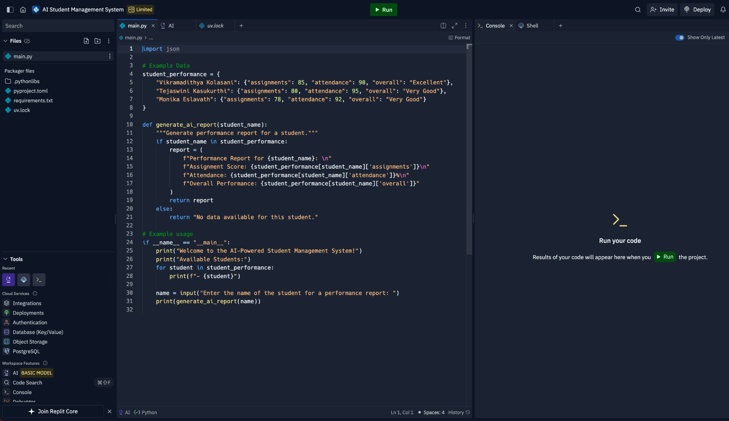
Main.py code

Slide 8
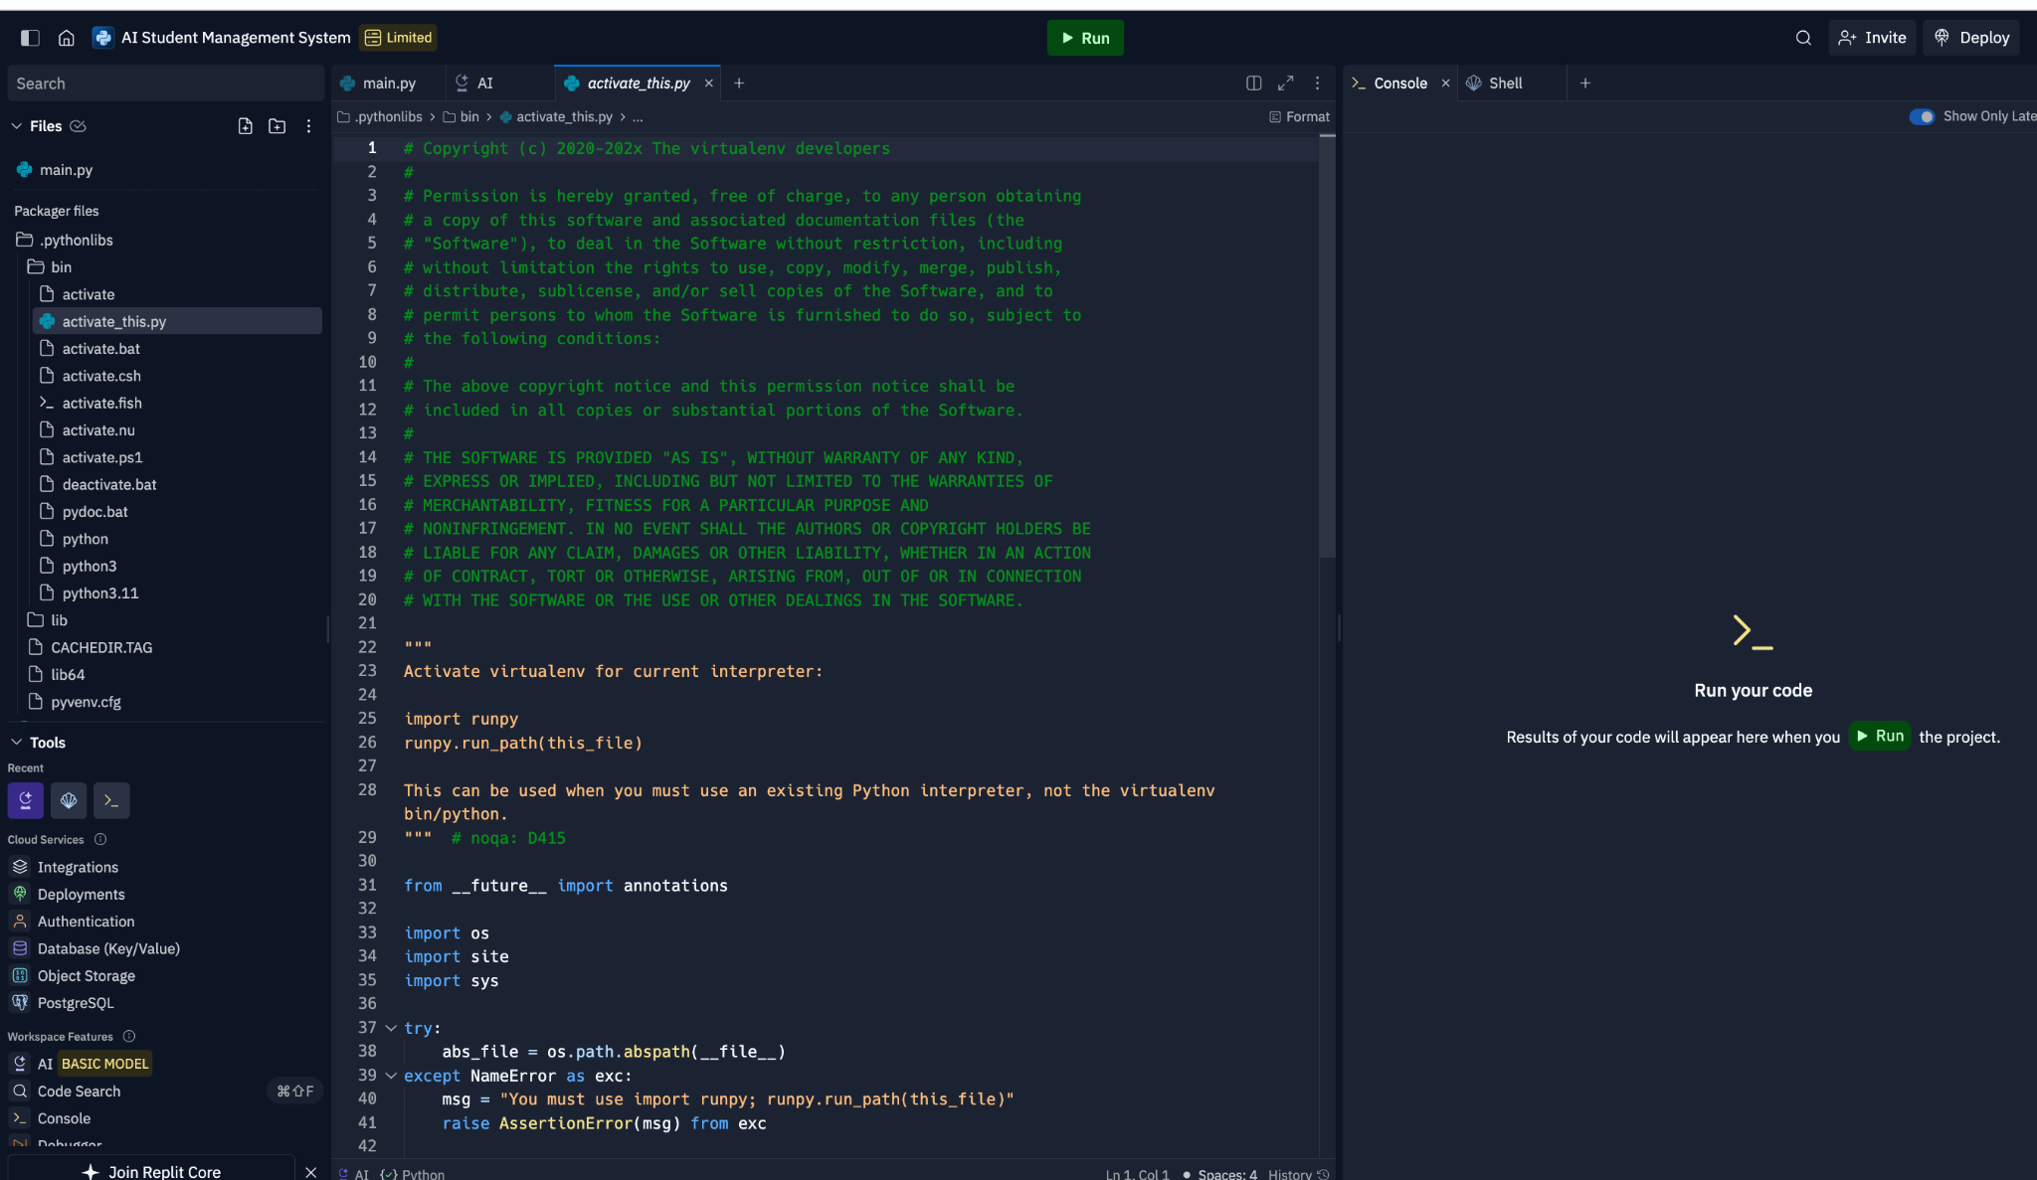
Activate_py

Slide 9
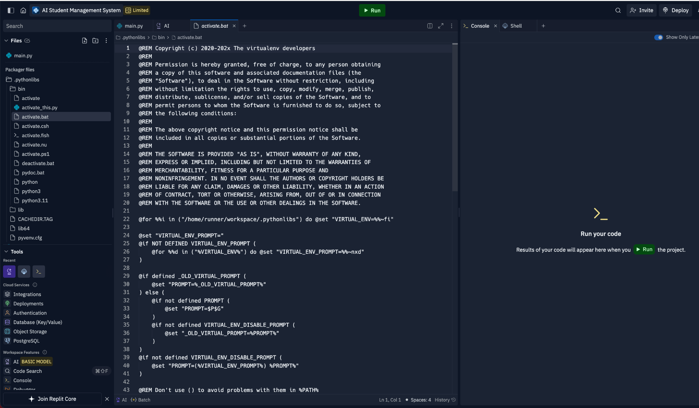
AI STUDENT MANAGEMENT SYSTEM

Slide 10
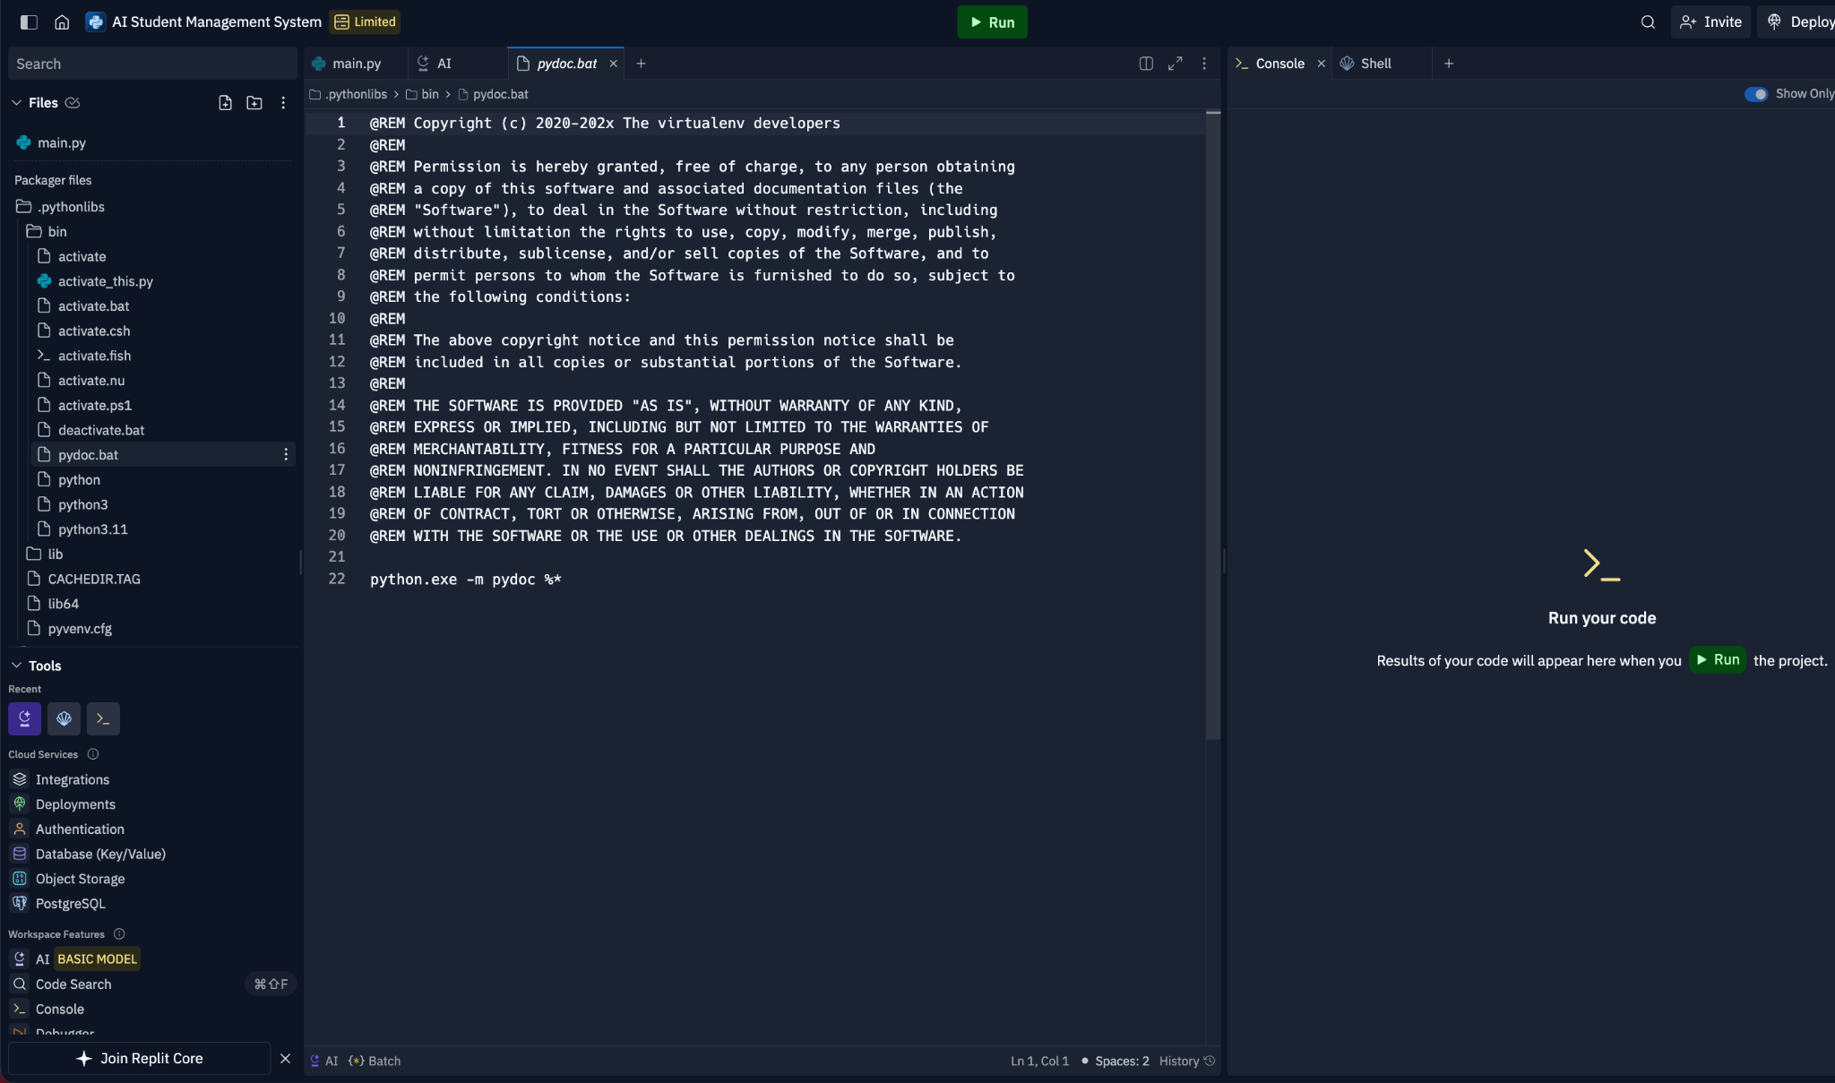
PYDOC.BAT

Slide 11
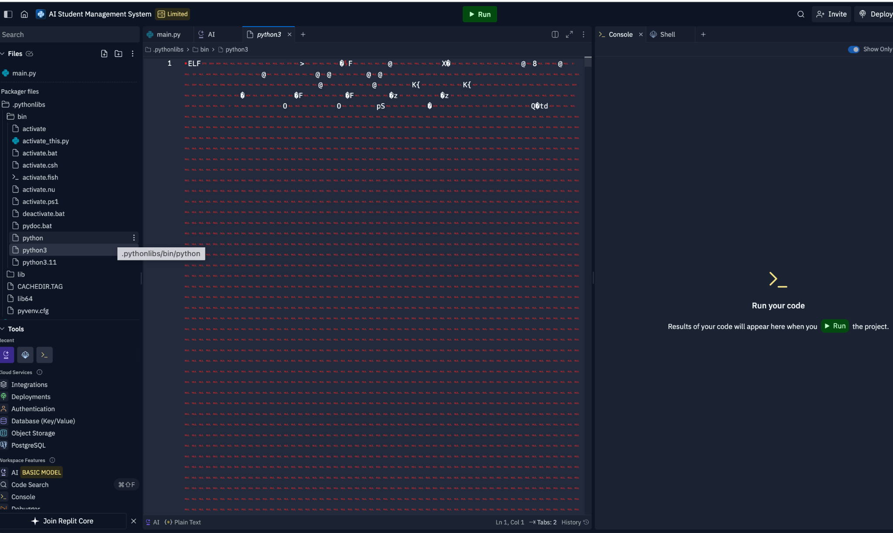
python3

Slide 12
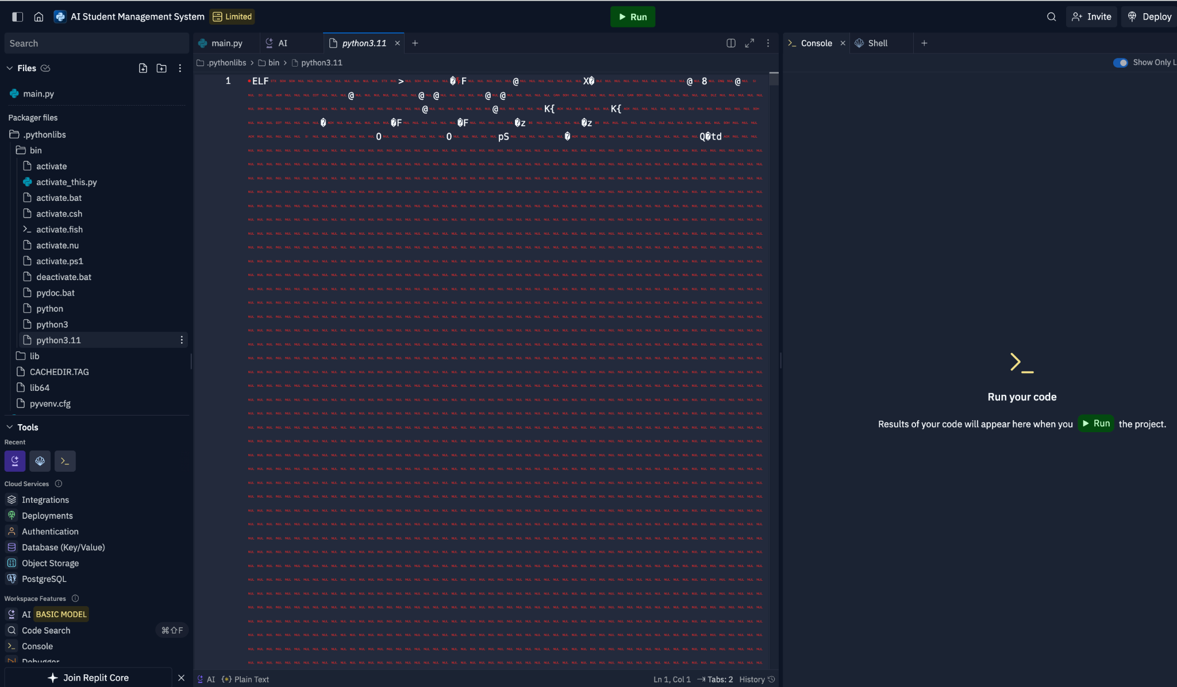

Slide 13
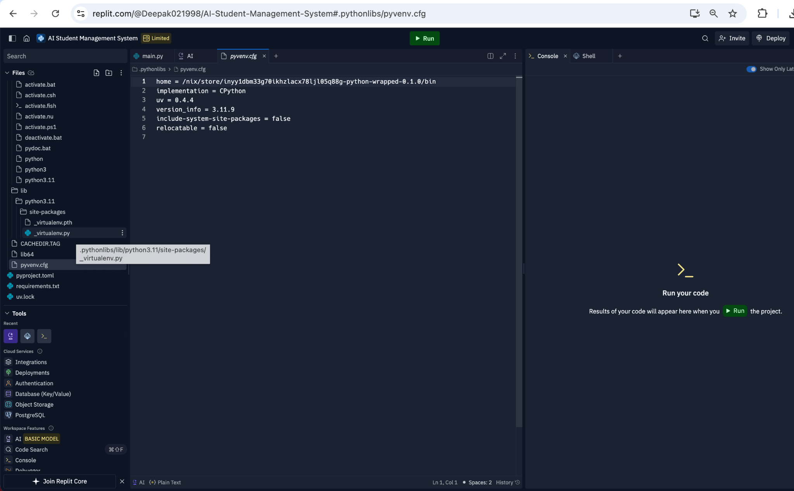

Slide 14
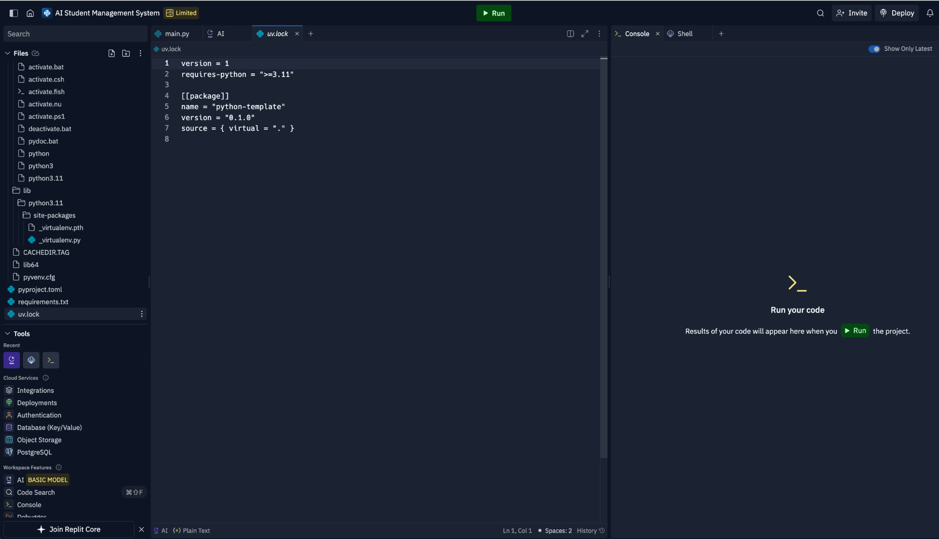

Slide 15
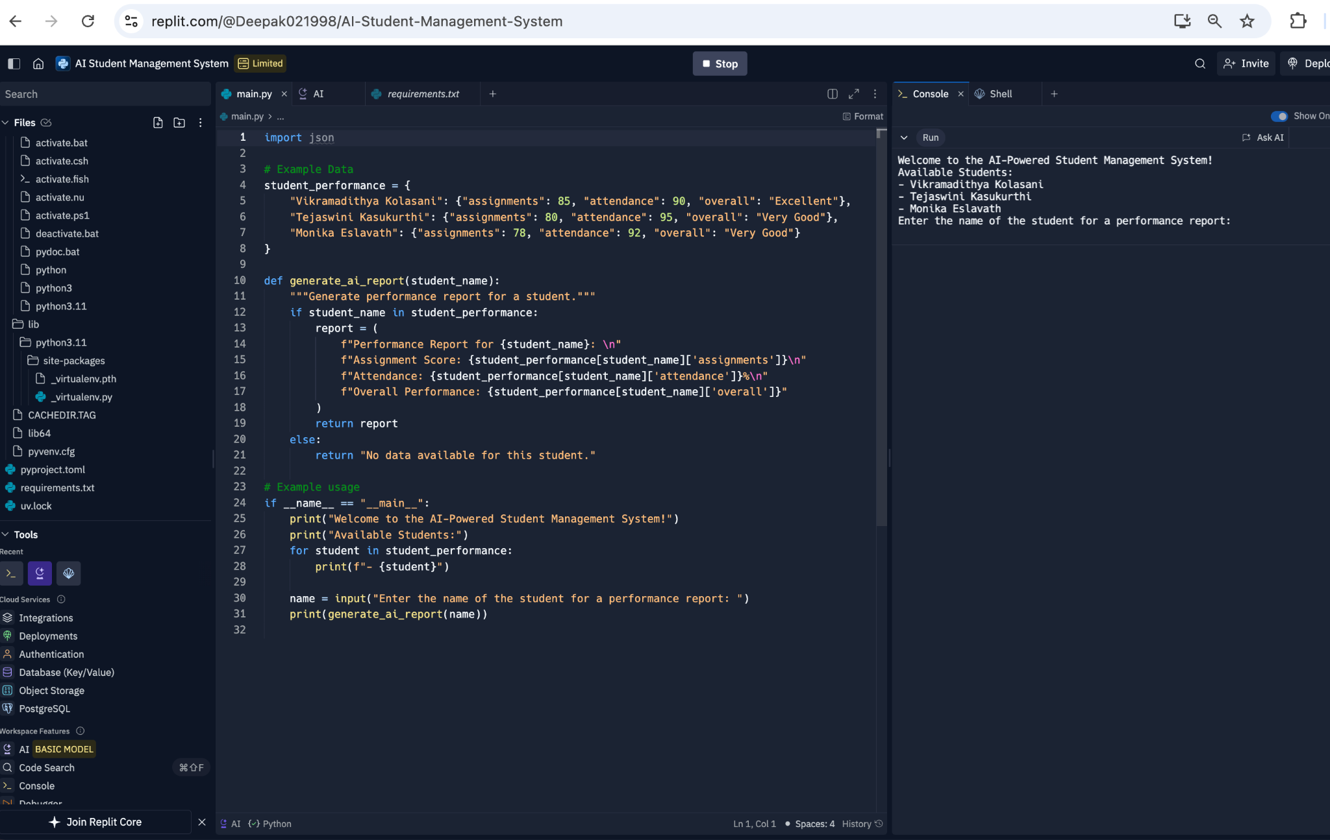

Slide 16

Conclusion
Conclusion
- The AI-Powered Student Management System streamlines the process of monitoring and managing student performance, attendance, and assignments.
- With real-time data analytics and AI-driven insights, institutions can take proactive measures to enhance student outcomes.
- This project demonstrates the potential of integrating AI technology in academic environments to create smarter, more efficient workflows.
-Future Scope: Expanding functionalities such as predictive analytics for dropout risks and personalized learning recommendations.
---

